Slide 1
Infection risk > 100 days post-HSCT with GVHD
A Pediatric Transplant Infectious Diseases Learning Module

Slide 2
Using the Modules
The modules are case-based, with decision points (branches) containing questions
Many questions don’t have right or wrong answers
Click on a response (e.g. a diagnostic test), and you will find out more about it
Multiple “action buttons” help you navigate
The basic modules are designed to take about 45 minutes to complete
You might take longer, especially if you choose to investigate all of the informational links provided
Take your time and enjoy!
Notes:
Sample slide to insert at the start of the module

Slide 3
Navigating the Modules
DO NOT use your keyboard arrows or mouse click to advance slides
Only use the navigation buttons on each slide – these will keep you from getting lost
If you do get lost, you can hit the “home” button any time to go back
Unlabeled button types you might encounter:
Previous slide
Next slide
First slide
More information
Return to decision choices
Notes:
Sample slide to insert at the start of a module

Slide 4
To Navigate module, please use BACK and NEXT buttons or master navigation slide at the end of the module Top Left corner: correlates to the American Board of Pediatrics, Pediatric ID content reference
This slide is NOT part of case presentation. Provided for reference only.

Slide 5
Meet Cooper
He is a 4 year old male s/p hematopoietic stem cell transplant from a matched unrelated donor 120 days ago for Wiskott-Aldrich who presents with acute-onset fever of 101°F (oral), emesis and general malaise.
His post-transplant course complicated by graft versus host disease (GvHD) of skin/GI tract, still on immunosuppressive therapy with tacrolimus and is on a taper of oral prednisone after a recent flair.
He is prescribed TMP-SMZ twice daily on weekends, though the family reports difficulty remembering to take this medication regularly.
Notes:
2 to 3

Slide 6
Additional History
ROS: negative for rash, cough, diarrhea, ill contacts
Pre Transplant serologies
CMV: Donor-/Recipient-
EBV: Donor+/Recipient-
HSV: IGG Positive
VZV: IGG Positive
WBC: 1.4 K/mcl | AST: 20 u/L
ALC: 0.8 K/mcl | ALT: 35 u/L
ANC 0.6 K/mcl | Total IGG: 250 mg/dL
Hgb: 8.5 g/dL
Plt: 140 K/mcl
Notes:
3 to 4

Slide 7
Physical Exam
BP 92/43, HR 115, T 37.8 axillary, RR 16, SpO₂ 99%
General: Moderately ill appearing
HEENT: MMM, no conjunctivitis or congestion
CHEST: Clear to auscultation, no murmurs
ABDOMEN: Diffuse tenderness, no rebound, bowel sounds present
EXTREMETIES: Warm and well perfused
SKIN: Scattered patches of hyper and hypo pigmentation stable to prior exam, no rash
No central access (e.g. port) at time of presentation
Notes:
4 to 5

Slide 8
Blood cultures are drawn and you are asked what organism is most likely to cause of his illness?
Staphylococcus aureus
Streptococcus pneumoniae
Pneumocystis jirovecii
Viridans streptococci
Pseudomonas
aeruginosa
Notes:
5 to 6, 7,8, 9, 10

Slide 9
Staphylococcus aureus
Common cause of bacteremia in immunocompromised hosts
Empiric coverage for methicillin-resistant S. aureus (MRSA) should be considered depending on local resistance patterns.
Risk is lower given the lack of central line
Coagulase negative staphylococci much more common than MRSA.
CDC/ Dr. Richard Facklam
Notes:
6 to 5

Slide 10
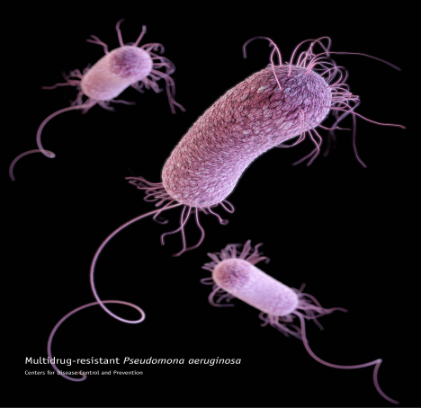
Pseudomonas aeruginosa
Pseudomonas and other Gram negative pathogens are associated with high mortality rates though less common than Gram positive bacteria.
GVHD likely increases the risk of infection due to continued inadequate immune response.
Multi-drug resistance continues to be an increasing problem.
CDC/ James Archer
Kikuchi et al. Transplant Infectious Disease 2015
Notes:
7 to 5

Slide 11
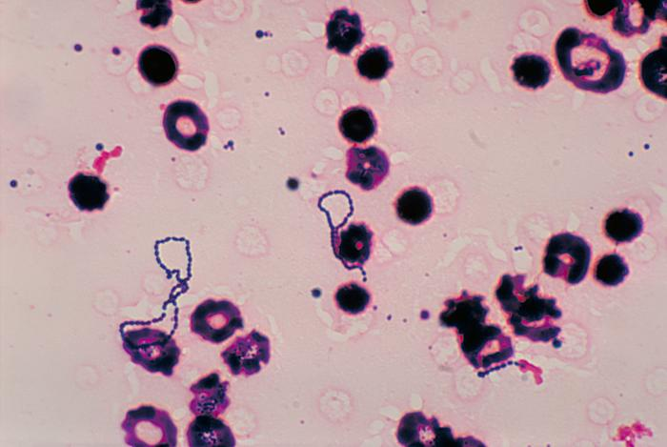
Viridans streptococci
Common infection during in those receiving chemotherapy and immediately after transplant when mucositis is most common.
Associated with more severe illness and may be more likely to develop acute respiratory distress syndrome (ARDS).
Often resistant to penicillin and fluoroquinolones.
CDC/ Dr. Mike Miller
Notes:
8 to 5

Slide 12
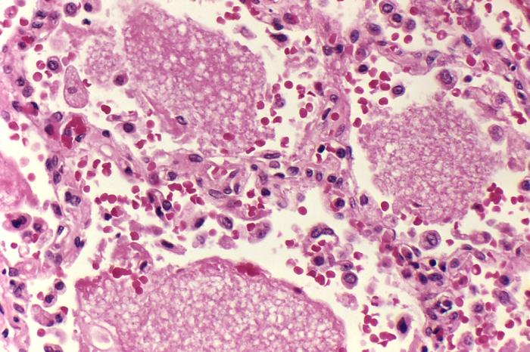
Pneumocystis jirovecii
High risk through 6 months of transplant as well as in those with GVHD due to ongoing immunosuppression.
Despite the patient being at high risk for Pneumocystis pneumonia (PCP) his presentation is not particularly consistent given lack of respiratory symptoms.
CDC/ Dr. Edwin P. Ewing, Jr.
Notes:
9 to 5

Slide 13
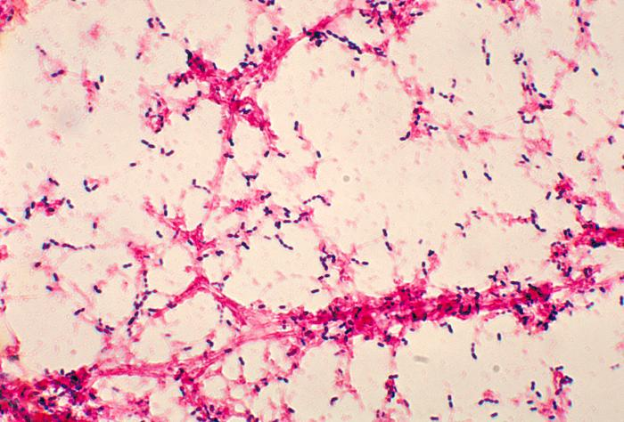
Streptococcus pneumoniae
Correct!
Significant pathogen in the late post-transplantation period
Months, even years, after transplant
Pneumococcal bacteremia is rare during neutropenic phase early post-BMT
Predisposing factors:
Functional hyposplenism
Decreased IgG and pneumococcal antibody following allogeneic HSCT
Impaired opsonizing activity for S. pneumoniae
CDC/Dr. Mike Miller
Gudiol C, et al. Bone Marrow Transplant. 2014
Kulkarni S, et al. Blood. 2000
Youssef S, et al. Medicine. 2007
Notes:
10 to 11

Slide 14
Late onset bacteremia
Acute and chronic GVHD are risk factors for BSI in allogeneic transplant recipients.
B- and T-cell depletion, impairment of lymphocyte function, hypogammaglobulinemia, and neutropenia all increase risk of infection.
Exacerbated by corticosteroid therapy administered to treat GVHD
Castagnola. Biol Blood Marrow Transplant. 2014
Notes:
11 to 12

Slide 15
After discussing your concern for S. pneumoniae you recommend empiric therapy with?
Cefepime
Meropenem plus
Vancomcyin
Cefepime plus
Vancomycin
Ceftriaxone
Notes:
12 to 13, 12 to 14,12 to 15, 12 to 16

Slide 16
Cefepime
Fourth generation cephalosporin
Efficacy of this antibiotic against S. pneumoniae will depend on local resistance rates
Generally better gram-positive coverage than ceftazidime
Notes:
13 to 17

Slide 17
Cefepime + Vancomycin
Reasonable option if:
Suspect catheter related infection
Skin soft tissue infection
Hemodynamic instability
Risk factor for resistant organism
Notes:
14 to 12

Slide 18
Ceftriaxone
Generally a good choice for greater than 100 days after transplant and no central line.
In light of ongoing GVHD treatment, many centers would utilize an agent that has pseudomonal coverage.
Notes:
15 to 12

Slide 19
Meropenem + Vancomcyin
Extremely broad coverage for an individual not in shock, no history of resistant organisms, and no positive cultures.
Notes:
16 to 12

Slide 20
Case continued
The patient has been on antibiotics for more than 48 hours and is steadily looking more ill with increasing complaints of abdominal pain and some distention though his physical exam is otherwise unchanged.
Vitals have been consistent
Abdominal U/S and subsequent CT remarkable for possible ileus
Aerobic blood culture, and subsequent anaerobic and fungal cultures show no growth
Electrolytes remarkable for persistent hyponatremia (Na 122 mmol/L)
Notes:
17 to 18

Slide 21
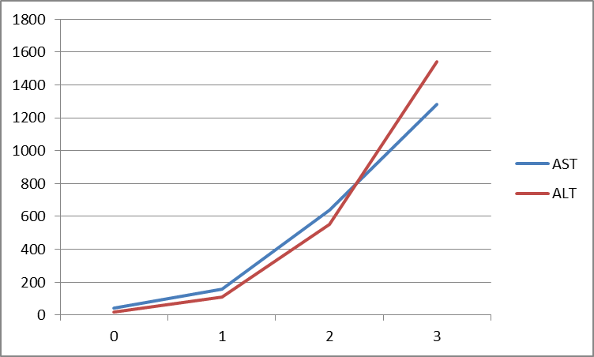
Case continued
He has been having daily lab work which shows increasing liver function tests.
Notes:
18 to 19

Slide 22
Case continued
Your differential includes the following etiologies and you send for these additional tests:
CMV | CMV PCR blood
Adenovirus | Adenovirus PCR Blood
Varicella | VZV PCR blood
HSV | HSV PCR blood
Resistant bacteria | Repeat blood culture
Notes:
19 to 20

Slide 23
What is your next step?
Await test results
IV cidofovir
(Adenovirus)
Colistin
(Resistant Gram- negative bacteria)
IV ganciclovir
(CMV)
IV acyclovir
(Varicella)
Notes:
20 to 21, 20 to 22, 20 to 23, 20 to 24, 20 to 25

Slide 24
CMV
Thought of as an early complication though increasingly clear it can have late effects particularly in those with GVHD.
Steps to diagnose include evaluating PCR in blood though tissue staining of biopsy is needed on some occasions.
Can cause transaminitis
Patient’s serologies make CMV less likely
This Patient’s Results
TEST | RESULT
CMV PCR Blood | Negative
Boeckh M, Ann Intern Med 2015; 162:1-10.

Slide 25
Adenovirus
Adenovirus is another viral infection that can re-activate causing a wide variety of symptoms ranging from lower respiratory tract infection to hepatitis and gastroenteritis.
Adenovirus can cause a transaminitis though usually not to this degree.
This Patient’s Results
TEST | RESULT
Adenovirus PCR Blood | Negative
Respiratory Viral PCR | Negative
Adenovirus stool Ag | Negative

Slide 26
Resistant gram negative bacteria
Multiple drug resistant organisms are increasingly common though lack of prior resistant infections, and negative blood cultures make this option less likely.
Bacterial infections are often not associated severe abdominal pain.
Colistin is an extremely nephrotoxic agent and should be reserved for cases where resistance is documented or there is a very high index of suspicion.

Slide 27
Wait for test results
Although the patient is clinically stable the rapid rise in liver function test and serologic status raises concern for herpes virus infection and empiric treatment should generally be started if there is clinical suspicion.
Notes:
24 to 25

Slide 28
Varicella
Seropositive patients are at continued risk for VZV reactivation, particularly with immunosuppression.
Reactivation may be in a dermatome distribution or may be disseminated.
Symptoms may precede the rash by several or will never develop a rash.
This Patient’s Results
TEST | RESULT
Varicella Qualitative | Positive
Varicella Quantitative | > 1,000,000 copies
Doki N, Transpl Infect Dis. 2013
Notes:
25 to 26

Slide 29
VZV
Exposure
Treatment
Isolation
Notes:
26 to 27, 26 to 28, 26 to 30

Slide 30
Isolation
If suspicion for local or disseminated varicella/zoster arises in an immunocompromised patient, they should be immediately isolated under airborne precautions.
AAP Red Book 2015
Notes:
27 to 26

Slide 31
Exposed
Immunocmpromised individuals
Varizig or IVIG within 10 days (ideally 96 hours)
Prophylactic acyclovir may be given though there is little supporting evidence
Immunocompetent susceptible to VZV
Varicella vaccine within 3-5 days
IVIG if unable to receive vaccine
AAP Red Book 2015
Notes:
28 to 29

Slide 32
Exposed
All exposed patients who can not leave the hospital should be placed in isolation during days 8 through 21 after exposure.
AAP Red Book 2015
Notes:
29 to 26

Slide 33
Treatment
Intravenous acyclovir should be started immediately if suspect as delays increase mortality
Needs higher dose acyclovir than used for HSV
Intravenous IV acyclovir dosing for varicella
<1 year | 10 mg/kg every 8 hours
>1 year | 500 mg² every 8 hours
Notes:
30 to 31

Slide 34
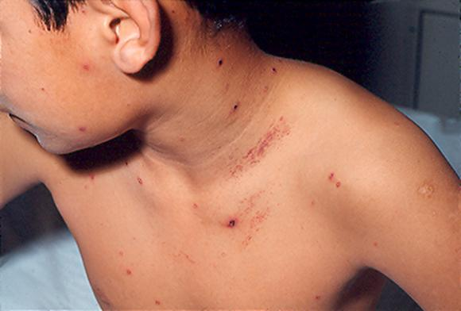
Case Conclusion
Cooper was started on IV acyclovir prior to the return of testing. Over the next few days he developed this rash confirming the diagnosis of disseminated varicella.
AAP Red Book 2015
Notes:
30 to 31

Slide 35
This module was developed by:
Ben Hanisch, MD, Children’s National Medical Center
Sanet Torres-Torres, MD, Children's Mercy Kansas City, MO
Original Version Date: 2016
Revised on:
Part of an educational effort through the PIDS Transplant Infectious Disease working group and the AST ID Community of Practice

Slide 36
Feedback on the Modules
PLEASE help to provide us with feedback on the content of these modules!
Let us know what you learned and what we can do better
Your feedback will help us to improve this work and design future modules
For any questions or concerns, please contact Tanvi Sharma tanvi.sharma@childrens.harvard.edu

