Slide 1
Disseminated Candida pre- and post- HSCT
A Pediatric Transplant Infectious Diseases Learning Module

Slide 2
Using the Modules
The modules are case-based, with decision points (branches) containing questions
Many questions don’t have right or wrong answers
Click on a response (e.g. a diagnostic test), and you will find out more about it
Multiple “action buttons” help you navigate
The basic modules are designed to take about 45 minutes to complete
You might take longer, especially if you choose to investigate all of the informational links provided
Take your time and enjoy!
Notes:
Sample slide to insert at the start of the module

Slide 3
Navigating the Modules
DO NOT use your keyboard arrows or mouse click to advance slides
Only use the navigation buttons on each slide – these will keep you from getting lost
If you do get lost, you can hit the “home” button any time to go back
Unlabeled button types you might encounter:
Previous slide
Next slide
First slide
More information
Return to decision choices
Notes:
Sample slide to insert at the start of a module

Slide 4
Case Presentation
Case
26 month old female
Presented with fever, pallor, petechial rash, and pancytopenia was diagnosed with high-risk AML based on a complex karyotype.
Remission was successfully achieved and she will shortly undergo matched-unrelated T cell depleted HSCT with bone marrow as the cellular source.

Slide 5
Case Presentation
Case
26 month old female
She had three episodes of fever and neutropenia during her initial chemotherapy for AML.
Two episodes were culture negative
Third was associated with Klebsiella pneumoniae bacteremia with two positive blood cultures on consecutive days that cleared without CVC removal
One episode with prolonged fever for which she received 10 days of empiric micafungin prior to resolution of fever and recovery from neutropenia (imaging and lab evaluation normal at that time).

Slide 6
Case Presentation
Case
26 month old female
During her periods of neutropenia with AML chemotherapy she received fluconazole prophylaxis (6 mg/kg/day). Her current vascular access is a port that was placed following AML diagnosis.
Question
What is the recommended antifungal prophylactic regimen for this patient?
Fluconacole
Echinocandin (Micafungin/Caspofungin)
Voriconazole
Posaconazole

Slide 7
Fluconazole in HSCT Antifungal Prophylaxis
Spectrum of action:
Limited to Candida spp., Cryptococcus neoformans, and endemic/dimorphic fungi
“Fluconazole is the drug of choice for the prophylaxis of invasive candidiasis before engraftment in allogeneic HCT recipients, and may be started from the beginning or just after the end of the conditioning regimen (AI)”
Fluconazole prophylaxis dosing
6mg/kg/dose given once daily (maximum daily dose = 400mg/day)
Goodman LJ et al. N Engl J Med 1992; 326: 845–851
Slavin MA et al. J Infect Dis 1995;171: 1545-52.
Tomblyn M et al. Biol Blood Marrow Transplant 2009; 15: 1143-1238.

Slide 8
Echinocandins in HSCT Antifungal Prophylaxis
Spectrum of action:
fungicidal against Candida spp., fungistatic against Aspergillus spp.
Yeast prophylaxis
“Micafungin is an alternative prophylactic agent, as 1 study has shown it to be comparable to fluconazole for preventing possible or documented fungal infection (BI)”
Mold prophylaxis
“One study has shown micafungin to be effective in preventing invasive fungal infections (including fever) when administered during neutropenia . . . but the incidence of invasive aspergillosis is low during the preengraftment phase, so anti-mold efficacy could only show a display of activity rather than efficacy (BI). Experience with other echinocandins (eg, caspofungin) demonstrates some efficacy (CII), but breakthrough mold infections during echinocandin prophylaxis have been reported. ”
van Burik JA et al. Clin Infect Dis 2004; 39: 1407–1416
Tomblyn M et al. Biol Blood Marrow Transplant 2009; 15: 1143-1238.

Slide 9
Voriconazole in HSCT Antifungal Prophylaxis
Spectrum of action:
Candida, Aspergillus, Fusarium, endemic/dimorphic fungi, Malassezia spp, Scedosporium, dematiaceous molds (*not Mucormycosis*)
Primary Literature (Wingard et al. 2010)
Randomized controlled trial fluconazole vs. voriconazole prophylaxis in HSCT >2 yrs of age (8.5% of subjects <18 yrs)
No significant difference between drugs with regard to freedom from invasive fungal infection or fungal free survival
Caveat: study performed in context of structured galactomannan-based ‘screening’ program
Tomblyn M et al. Biol Blood Marrow Transplant 2009; 15: 1143-1238.
Wingard JR et al. Blood 2010; 116: 5111-8.

Slide 10
Posaconazole in HSCT Antifungal Prophylaxis
Spectrum of action:
Mucormycosis, Candida, Aspergillus spp., Fusarium, endemic/dimorphi fungi, Malassezia spp., Scedosporium, dematiaceous molds
Primary Literature (Ullman et al. 2007)
Randomized controlled trial of posaconazole versus fluconazole in HSCT patients with GVHD on immunosuppression
Trend toward decreased proven or probable invasive fungal infection in posaconazole versus fluconazole group (5.3% vs. 9.0%, p=0.07)
Significantly decreased invasive aspergillosis in posaconazole versus fluconazole group (2.3% vs. 7.0%, p=0.006)
Tomblyn M et al. Biol Blood Marrow Transplant 2009; 15: 1143-1238.
Ullmann AJ et al. N Engl J Med 2007; 356: 335-347

Slide 11
Case Presentation: Hospital Course
Case
The patient undergoes preparative regimen followed by stem cell infusion and receives fluconazole prophylaxis.
On the third day (d+3) after cell infusion she develops fever (ANC 0). She has no evidence of hemodynamic compromise.
Exam:
Her port site shows no erythema or induration and she has no localizing symptoms or signs.
Evaluation:
Peripheral and central blood cultures are obtained
She is started on Cefepime and remains on fluconazole.
Initial blood cultures are negative and daily blood cultures are obtained.

Slide 12
What is your differential diagnosis for fever and neutropenia in a pediatric HSCT patient early post-HSCT?
Bacterial bloodstream infection
Respiratory viral infection
CMV syndrome/infection
Mold infection/invasive aspergillosis
Invasive candidiasis

Slide 13
Bacterial bloodstream infection in pediatric HSCT recipients
Potential cause of infection early post-transplant
Can cause fever without localizing signs
Highest risk period is pre-engraftment
List of potential bacterial etiologies depends on antecedent infection history, antibiotic therapy, and antibiotic prophylaxis if used
Gram-positive bacteria
Staphylococcus aureus
Coagulase-negative staphyloccci
Viridans streptococci
Enterococcus faecium/faecalis
Streptococcus pneumoniae
Streptococcus pyogenes
Gram-negative bacteria
Escherichia coli
Klebsiella pneumoniae
Enterobacter spp
Pseudomonas aeruginosa
Citrobacter spp
Stenotrophomonas maltophilia

Slide 14
Respiratory viral infection in pediatric HSCT recipients
Usually associated with respiratory symptoms
May be acquired pre-transplant and lead to disease post-transplant
Etiologies
Influenza
RSV
Metapneumovirus
Parainfluenza
Adenovirus
Rhinovirus

Slide 15
CMV syndrome/infection in pediatric HSCT recipients
CMV viremia is often asymptomatic and detected by screening at regular intervals post-transplant
Preemptive or prophylactic approaches are used for CMV prevention in pediatric HSCT recipients
In one pediatric study (Rowe et al. 2016) median onset of CMV infection was 46 days after graft infusion (range 9-127 days)
Rowe RG et al. Biol Blood Marrow Transplant 2016; S1083-8791

Slide 16
Mold infection in pediatric HSCT recipients
Invasive mold infection (primarily Aspergillus spp.) in HSCT recipients has a biphasic peak with an early peak corresponding to the pre-engraftment phase (0-30 days) and a later peak corresponding to onset of GVHD and GVHD related immunosuppression.
Etiologies
Aspergillus spp.
Murcorales
Fusarium
Scedosporium

Slide 17
Invasive Candidiasis in pediatric HSCT recipients
Invasive candidiasis usually occurs in the neutropenic, pre-engraftment period post-HSCT
Origin of invasive candidiasis is usually from endogenous colonization of gastrointestinal tract.
Post-transplant antifungal prophylaxis decreases frequency of invasive candidiasis
Fluconazole-resistant Candida isolates exist and are increasing in frequency

Slide 18
Case Presentation: Hospital Course
Case
On day +7 she remains febrile with ANC of 0. The microbiology lab calls and reports that the port blood culture from day d+6 is growing yeast, probable Candida species.
What recommendation for antifungal therapy and what dosing do you make?
Fluconazole
Echinocandin

Slide 19
Fluconazole is NOT first line treatment for Candidemia in the neutropenic patient
Echinocandins are recommended as initial therapy for candidemia in neutropenic patients (strong recommendation, moderate quality evidence)
Fluconazole is an alternative if the patient is not critically ill and has no prior azole exposure (weak recommendation; low-quality evidence)
“Fluconazole can be used for step-down therapy during persistent neutropenia in clinically stable patients who have susceptible isolates and documented bloodstream clearance (weak recommendation; low-quality evidence).”
Dosing fluconazole for candidemia in appropriate setting
12 mg/kg (max 800mg) loading dose, then 6mg/kg (max 400mg) daily
Some pediatric experts recommending higher loading and treatment doses (up to 25mg/kg for loading dose and up to 12mg/kg/day for treatment dose)
Pappas PG et al. Clin Infect Dis 2016; 62: e1-e50

Slide 20
Echinocandins ARE the recommended initial therapy for Candidemia in neutropenic patients
Echinocandins are recommended as initial therapy in for Candidemia in neutropenic patients (strong recommendation, moderate quality evidence)
Fluconazole is an alternative if the patient is not critically ill and has no prior azole exposure (weak recommendation; low-quality evidence)
Echinocandin dosing for Candidemia
Micafungin
2mg/kg/dose once daily (max dose 100mg daily)
Caspofungin
70mg/m²/dose on day 1 followed by 50mg/m²/dose once daily
*Check appropriate updated dosing recommendations. Higher doses can be used in setting of esophageal candidiasis and treatment-refractory Candidemia

Slide 21
Case Presentation: Hospital Course
Case
The patient is started on Micafungin while awaiting further identification and susceptibility results.
What recommendation do you make regarding line salvage versus line removal?
Treat with port in place
Remove port and treat through peripheral IV

Slide 22
Central Line Removal for Candidemia (1 of 3): Guideline Recommendations
IDSA recommendations
“Central venous catheters (CVCs) should be removed as early as possible in the course of candidemia when the source is presumed to be the CVC and the catheter can be removed safely; this decision should be individualized for each patient (strong recommendation; moderate-quality evidence).”
“In the neutropenic patient, sources of candidiasis other than a CVC (eg, gastrointestinal tract) predominate. Catheter removal should be considered on an individual basis (strong recommendation; low-quality evidence).”
Pappas PG et al. Clin Infect Dis 2016; 62: e1-e50

Slide 23
Central Line Removal for Candidemia (2 of 3): Primary Literature
Retrospective cohort study of pediatric patients with candidemia
Primary outcome: 30-day all cause inpatient mortality
N=285 patients with Candidemia and CVC in place
Patient characteristics at time of blood culture
Median age: 2 years
IQR: 0.7-11.6 yrs
ICU admission – 42%
Dialysis – 2.8%
Receipt of TPN – 63.9%
Immunosuppression – 20.3%
Surgery in prior 2 weeks – 26.3%
Overall mortality – 10.5%
CVC retention was significantly associated with 30-day all cause inpatient mortality
Discrete time-failure model
Adjusted for age and complexity of clinical care
OR 2.50; 95% CI, 1.06–5.91
Limitations included unmeasured confounders related to severity of illness
Fisher BT et al. J Pediatric Infect Dis Soc 2015, Aug 16 [Epub ahead of print]

Slide 24
Central Line Removal for Candidemia (3 of 3): Primary Literature
Patient level quantitative review of randomized Candidemia treatment trials
Primary outcome: 30 day all-cause mortality
Patient characteristics
Mean patient age: 55.1 years
78% with central venous catheters
4.8% with transplantation
28.6% on immunosuppressive therapy
84.8% with bloodstream infection
Overall 30 day mortality – 31.4%
CVC removal during treatment associated with improved survival
CVC removal, 28% 30-day mortality
CVC retention, 41% 30-day mortality
Candidemia subgroup
OR for 30 day mortality with CVC removal
OR 0.45; 95% CI 0.31-0.67, p=0.0001
Andes DR et al. Clin Infect Dis 2012; 54: 1110-22

Slide 25
Case Presentation: Hospital Course
Case
The port is removed, but given concerns regarding access and need for ongoing parenteral nutrition, a PICC was placed concurrently with line removal.
Daily blood cultures are obtained and on day +9 she remains febrile and has positive blood cultures for yeast on days +6, +7, and +8. The isolate from day +6 has been identified as Candida glabrata and is fluconazole resistant.
What recommendation do you make regarding treatment of Candida glabrata in this patient?
Continue treatment with echinocandin
Change treatment to Lipid-formulation Amphotericin B

Slide 26
Epidemiology of Invasive Candida Infection
Speciation for pediatric invasive Candidiasis
Candida species | # (total =449) | %
C. albicans | 180 | 40%
C. parapsilosis | 100 | 22%
Other Candida spp. | 62 | 14%
C. glabrata | 40 | 9%
C. lusitaniae | 24 | 5%
C. krusei | 16 | 4%
Unknown Candida species | 11 | 2%
C. guilliermondii | 9 | 2%
C. dubliniensis | 7 | 2%
Steinbach WJ et al. Pediatr Infect Dis J 2012; 31: 1252-7
Palazzi D et al. Pediatr Infect Dis J 2014;33: 1294-6

Slide 27
Epidemiology of Antifungal Resistance in Candida
General resistance patterns by Candida species
C. albicans
generally susceptible
C. parapsilosis
Occasional echinocandin resistance
Controversy regarding poorer outcomes with echinocandin treatment
C. tropicalis
Rarely fluco-R
C. glabrata
Frequently fluco-R
Rising echinocandin-R
Rare Ampho B-R
C. krusei
Frequent fluco-R
Rare AmphoB - R

Slide 28
Epidemiology of Antifungal Resistance in Candida
Increasing frequency of concurrent resistance against fluconazole and echinocandins is reported in C. glabrata isolates.
Candida glabrata resistance in two large surveillance programs (Pfaller et al. 2012)
SENTRY Antimicrobial surveillance program AND CDC population-based surveillance
2006 – 2010
9.7% isolates resistant to fluconazole
11.1% of fluconazole-resistant isolates also resistant to ≥ 1 echinocandin
Prior surveillance (2001-2004) indicated no echinocandin resistant C. glabrata strains among those with fluconazole resistance
Pfaller MA et al. J Clin Microbiol 2012; 50: 1199-1203
Alexander BD et al. Clin Infect Dis 2013; 56: 1724-32.

Slide 29
Epidemiology of Antifungal Resistance in Candida
Increasing frequency of concurrent resistance against fluconazole and echinocandins is reported in C. glabrata isolates.
Single-center retrospective review of C. glabrata bloostream isolates (n=313) from 2001 – 2010 (Alexander et al. 2013)
Echinocandin resistance increased from 4.9% to 12.3% of isolates across study period
Fluconazole resistance increased from 18% to 30% of isolates across study period
Pfaller MA et al. J Clin Microbiol 2012; 50: 1199-1203
Alexander BD et al. Clin Infect Dis 2013; 56: 1724-32.

Slide 30
Case Presentation: Hospital Course
Case
Based on persistent positive cultures while undergoing treatment with micafungin and her prior exposure to micafungin during her pretransplant course, you are concerned that her C. glabrata isolate has both fluconazole and echinocandin resistance. You initiate treatment with liposomal Amphotericin B.

Slide 31
Case Presentation: Hospital Course
Case
C. glabrata susceptibility testing returns with fluconazole resistance and echinocandin susceptibility. You choose to treat with micafungin.
What recommendation do you make regarding further management and evaluation for infection source in this patient?
Echocardiogram
Abdominal US
Chest CT
Eye exam
PICC removal

Slide 32
Disseminated Candidiasis
Definition: Disease caused by tissue invasive Candida infection
Frequency: 8.3 – 17% of children with candidemia have evidence of dissemination
Relative frequency of anatomic dissemination sites
Lungs > Liver > Kidney > Heart > Spleen > Eyes
Zaoutis TE et al. Pediatr Infect Dis J 2004; 23: 635-641
Chapter 198 Feigin and Cherry’s Textbook of Pediatric Infectious Diseases, 7th ed. 2014

Slide 33
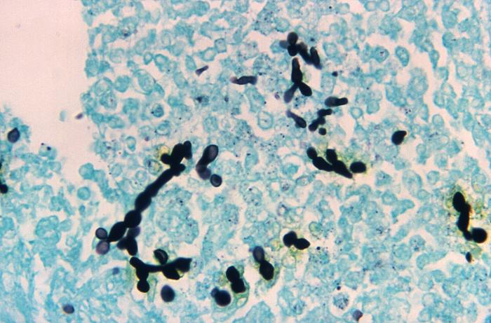
Endovascular Candidiasis
Infective endocarditis is the most common form
Pathogenesis is potentially related to endothelial trauma secondary to central venous catheters resulting in endocarditis
Septic thrombophlebitis and mycotic aneurysm also occur
Pericarditis and myocarditis are rare
500X GMS stain of human heart tissue showing
Candidal yeast forms and pseudohyphae
Accessed at http://phil.cdc.gov
Millar BC et al. Pediatr Cardiol 2005; 26: 517-536

Slide 34
Abdominal Candidiasis
Occurs in the setting of active/ongoing candidemia or after a previously asymptomatic seeding event (Hepatosplenic Candidiasis)
Kidney
Renal abscess
Renal mycetoma (fungal ball)
Liver or splenic abscesses

Slide 35
Hepatosplenic Candidiasis
Pathophysiology is thought to be asymptomatic dissemination during neutropenic period followed by persistent fever during neutrophil recovery
Liver and spleen primarily affected but can also involve other organs
Diagnosis
Blood culture low yield
Lesions detectable by US and/or CT with neutrophil recovery
Lesions may resolve with neutropenia despite continued presence of Candida in tissue and continued need for antifungal treatment
Computed tomography of abdomen in patient with hepato-
splenic Candidiasis. Images show multiple low attenuation
lesions in the hepatic (arrows) and renal (arrowheads)
parenchyma. Photo courtesy of Daniel Dulek

Slide 36
Pulmonary Candidiasis
Three forms
Primary bronchopneumonia = rare
Secondary to hematogenous dissemination during Candidemia
Secondary to septic thromboemboli
Diagnosis requires histopathologic evidence of Candida invading lung tissue
BAL detection of Candida ≠ diagnostic for invasive disease
Chest imaging is not needed in every case of potential invasive Candidiasis unless it provides additional diagnostic information.
Chapter 198 Feigin and Cherry’s Textbook of Pediatric Infectious Diseases, 7th ed. 2014
Pappas PG et al. Clin Infect Dis 2016; 62: e1-e50

Slide 37
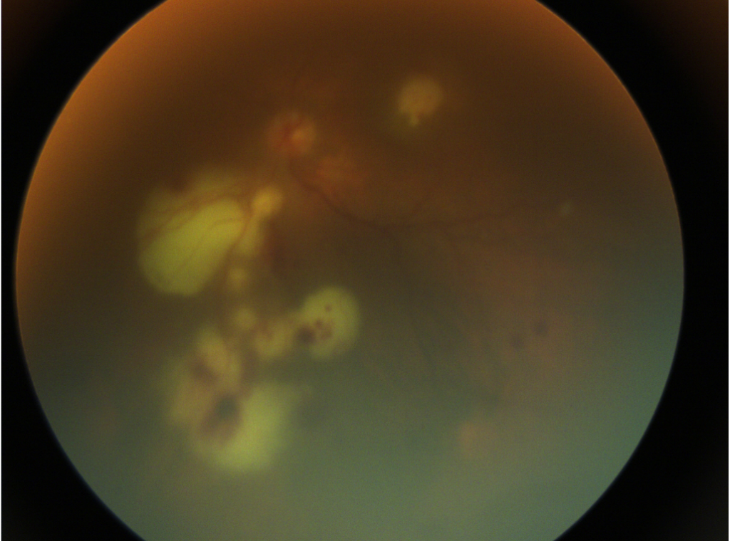
Ocular Candidiasis
Manifests as
Endophthalmitis
Chorioretinitis
Vitritis
Frequency of occurrence ranges from 2-19%
Pediatric study
8 out of 254 patients (2.9%) with Candidemia and dilated retinal exam had abnormality attributable to Candidal infection (Fierro et al. 2013)
Not limited to HSCT patients
Retinal photograph of a patient with C. tropicalis
chorioretinitis in the setting of multifocal disseminated
invasive Candidiasis.
Photo courtesy of Daniel Dulek
Fierro JL et al. Pediatr Infect Dis J 2013; 32:84–6.

Slide 38
Eye Exam Recommendation -- IDSA
“All patients with candidemia should have a dilated retinal examination, preferably performed by an ophthalmologist, within the first week of therapy in nonneutropenic patients to establish if endophthalmitis is present (strong recommendation; low-quality evidence). For neutropenic patients, it is recommended to delay the examination until neutrophil recovery (strong recommendation; low-quality evidence).”
Pappas PG et al. Clin Infect Dis 2016; 62: e1-e50

Slide 39
Case Presentation: Hospital Course
Case
On day +9 you request and obtain an echocardiogram, abdominal ultrasound, and ophthalmology exam for the patient.
The PICC is removed and antifungal therapy (micafungin) is administered by PIV.
Echocardiogram, US, and eye exam are normal. Two days (day +11) after PICC removal, fever resolves, blood culture from day +9 is positive for yeast but day +10 is negative.

Slide 40
Case Presentation: Hospital Course
Case
She is presently at day +14 with 3 negative blood cultures with at least 72 hours of growth.
Her current ANC is 0 and HSCT team anticipates 7-10 more days of neutropenia

Slide 41
Case Presentation: Hospital Course
Case
What treatment duration do you recommend for this patient?
2 weeks from bloodstream clearance irrespective of neutrophil recovery
2 weeks from bloodstream clearance as long as her ANC is >500 by treatment completion
2 weeks from bloodstream clearance with normalization of ANC and normal repeat eye exam and abdominal ultrasound

Slide 42
Invasive Candidiasis Treatment Duration (1 of 3)
Treatment duration: Candidemia in neutropenic patients
“Recommended minimum duration of therapy for candidemia without metastatic complications is 2 weeks after documented clearance of Candida from the bloodstream, provided neutropenia and symptoms attributable to candidemia have resolved (strong recommendation; low-quality evidence).”
”Ophthalmological findings of choroidal and vitreal infection are minimal until recovery from neutropenia; therefore, dilated funduscopic examinations should be performed within the first week after recovery from neutropenia (strong recommendation; low-quality evidence).”
Pappas PG et al. Clin Infect Dis 2016; 62: e1-e50

Slide 43
Invasive Candidiasis Treatment Duration (2 of 3)
Form of Disease | Antifungal | Duration | Other
Chronic disseminated (hepatosplenic) Candidiasis | Initial therapy with lipid formulation AmB or echinocandin for several weeks followed by step down to oral fluconazole | Until lesions on imaging resolve AND through period of ongoing immunosuppression
Native valve endocarditis | Lipid formulation AmB with or without flucytosine OR high-dose echinocandin as initial therapy Step down to fluconazole if isolate is susceptible, patient is clinically stable, and bloodstream has cleared. | Tx should continue at least 6 weeks post-surgery or longer if perivalvular abscess | Valve replacement recommended.
Suppurative thrombophlebitis | Lipid formulation AmB or fluconazole or echinocandin | At least two weeks after candidemia has resolved. | Catheter removal and incision/drainage or resection of the vein
Osteomyelitis | Fluconazole x 6-12 months with or without preceding 2 weeks of echinocandin | 6-12 months
Treatment duration for other forms of invasive Candidiasis
Pappas PG et al. Clin Infect Dis 2016; 62: e1-e50

Slide 44
Invasive Candidiasis Treatment Duration (3 of 3)
Form of Disease | Antifungal | Duration | Other
Septic arthritis | Fluconazole for 6 weeks, OR echinocandin for 2 weeks followed by at least 4 weeks of fluconazole | 6 weeks | Removal of prosthetic device recommended if present.
Chorioretinitis with or without vitritis | If susceptible, fluconazole or voriconazole. If –azole resistant, liposomal AmB with or without flucytosine. If macular involvement or vitritis, above PLUS intravitreal injection of AmB deoxycholate or voriconazole | At least 4-6 weeks depending on resolution of lesions based on repeat ophthalmological exams | Consult ophthalmology If vitritis present, Vitrectomy should be considered
CNS Candidiasis | Liposomal AmB with or without flucytosine. Step down to fluconazole once patient has responded | Treat until resolution of all CNS and/or radiologic abnormalities.
UTI with fungus balls | Oral fluconazole, OR AmB deoxycholate with or without fluctyosine. AmB deoxycholate irrigation through nephrostomy tubes if present | Duration not clearly defined | Surgical resection recommended in adults
Treatment duration for other forms of invasive Candidiasis
Pappas PG et al. Clin Infect Dis 2016; 62: e1-e50
Pappas PG et al. Clin Infect Dis 2016; 62: e1-e50

Slide 45
Case Presentation: Conclusion
Case
The patient continues treatment with micafungin continued through day +24 with neutrophil engraftment having occurred on day +22 (total treatment duration = 14 days)
Repeat dilated retinal exam by ophthalmology as well as abdominal ultrasound on day +21 were normal

Slide 46
Summary
Invasive candidiasis infection can occur in pediatric HSCT recipients despite antifungal prophylaxis
Frequency of fluconazole and echinocandin resistance may be increasing and is of particular concern with isolates of C. glabrata and C. krusei
Evaluation for localized sites of dissemination (Eyes, Heart, Liver, Kidneys, Spleen) is critical in the setting of fungemia
Manifestations of disseminated candidiasis may be delayed until after neutrophil recovery
Central line removal, if feasible, is a critical feature of the management of candidemia

Slide 47
References: Guidelines
Hope WW et al. ESCMID guideline for the diagnosis and management of Candida diseases 2012: prevention and management of invasive infections in neonates and children caused by Candida spp. Clin Microbiol Infect 2012; 18: 38-52.
Science M et al. Guideline for primary antifungal prophylaxis for pediatric patients with cancer or hematopoietic stem cell transplant recipients. Pediatr Blood Cancer 2014; 61: 393-400.
Tomblyn M et al. Guidelines for preventing infectious complications among hematopoietic cell transplantation recipients: a global perspective. Biol Blood Marrow Transplant 2009; 15: 1143-1238.
Pappas PG et al. Clinical Practice Guideline for the Management of Candidiasis: 2016 Update by the Infectious Diseases Society of America. Clin Infect Dis 2016; 62: e1-e50.

Slide 48
References: Primary Literature
Pediatric Epidemiology
Steinbach WJ et al. Results from a Prospective, International, Epidemiologic Study of Invasive Candidiasis in Children and Neonates. Pediatr Infect Dis J 2012; 31: 1252-57.
Prasad PA et al. Pediatric Risk Factors for Candidemia Secondary to Candida glabrata and Candida krusei species. J Pediatric Infect Soc 2013; 2: 263-6.
Zaoutis TE et al. Risk factors for disseminated candidiasis in children with candidemia. Pediatr Infect Dis J 2004; 23: 635-41.
Festekjian A et al. Incidence and Predictors of Invasive Candidiasis Associated with Candidemia in Children. Mycoses 2011; 54: 146-153.

Slide 49
References: Primary Literature
Treatment/Resistance
Mora-Duarte J et al. Comparison of caspofungin and amphotericin B for invasive candidiasis. N Engl J Med 2002; 347: 2020-9.
Betts R et al. Efficacy of caspofungin against invasive Candida or invasive Aspergillus infections in neutropenic patients. Cancer 2006; 106: 466-73
Kuse ER et al. Micafungin versus liposomal amphotericin B for candidemia and invasive candidosis: a phase III randomized double-blind trial. Lancet 2007; 369: 1519-27.
Alexander BD et al. Increasing echinocandin resistance in Candida glabrata: clinical failure correlates with presence of FKS mutations and elevated minimum inhibitory concentrations. Clin Infect Dis 2013; 56: 1724-32.
Kanji JV et al. Treatment of invasive candidiasis in neutropenic patients: systematic review of randomized controlled treatment trials. Leuk Lymphoma 2013; 54: 1479-87
Fernandez-Ruiz M et al. Initial use of echinocandins does not negatively influence outcome in Candida parapsilosis bloodstream infection: a propensity score analysis. Clin Infect Dis 2014; 58: 1413-21.

Slide 50
References: Primary Literature
Prophylaxis
Slavin MA et al. Efficacy and safety of fluconazole prophylaxis for fungal infections after marrow transplantation—a prospective, randomized, double-blind study. J Infect Dis 1995;171: 1545-52.
Goodman JL et al. A controlled trial of fluconazole to prevent fungal infections in patients undergoing bone marrow transplantation. N Engl J Med 1992; 326: 845–851
Wingard JR et al. Randomized, double-blind trial of fluconazole versus voriconazole for prevention of invasive fungal infection after allogeneic hematopoietic cell transplantation. Blood 2010; 116: 5111-8.
Ullmann AJ, Lipton JH, Vesole DH, et al. Posaconazole or fluconazole for prophylaxis in severe graft-versus-host disease. N Engl J Med 2007; 356: 335-347
Evaluation for dissemination
Fierro JL, Prasad PA, Fisher BT, et al. Ocular manifestations of candidemia in children. Pediatr Infect Dis J 2013; 32:84–6.

Slide 51
References: Primary Literature
Line removal
Andes DR et al. Impact of treatment strategy on outcomes in patients with candidemia and other forms of invasive candidiasis: a patient-level quantitative review of clinical trials. Clin Infect Dis 2012; 54: 1110-22.
Garnacho-Montero J et al. Impact on hospital mortality of catheter removal and adequate antifungal therapy in Candida spp. Bloodstream infections. J Antimicrob Chemother 2013; 68: 206-13
Fisher BT et al. Central Venous Catheter Retention and Mortality in Children with Candidemia: A Retrospective Cohort Analysis. J Pediatric Infect Dis Soc 2015;

Slide 52
Location Links within Slide Set
Candida epidemiology and resistance
Disseminated Candida infection
Treatment of invasive Candidiasis

Slide 53
This module was developed by:
Daniel E Dulek, MD, Vanderbilt University School of Medicine
William J Steinbach, MD, Duke University School of Medicine
Original Version Date: 3/15/2016
Revised on:
Part of an educational effort through the PIDS Transplant Infectious Disease working group and the AST ID Community of Practice

Slide 54
Feedback on the Modules
PLEASE help to provide us with feedback on the content of these modules! ​
Let us know what you learned and what we can do better​
Your feedback will help us to improve this work and design future modules​
​
For any questions or concerns, please contact Tanvi Sharma tanvi.sharma@childrens.harvard.edu ​
Notes:
Sample slide to insert for evaluations at the end of a module – for now, this slide will link to a polling function on the internet for a standardized post-test.

